Slide 1
Welcome to Parent info night!
Teachers will be doing a presentation at 6:30 and at 7:00 for parents who have multiple children in different classes.

Slide 2
At Elizabeth Barrett, we are in year two of Real-time Reporting. Real-time Reporting is a system designed to give you current information on how your child is doing instead of waiting for report cards to be released at designated times in the year.
This means you will only receive a final report card for your child at the end of the school year. As teachers we will be communicating your child's progress throughout the year using 2 digital platforms. This gives you the opportunity to see information about your child's progress on a regular and ongoing basis.

Slide 3
There are two ways to access information on how your child is doing in class...
PowerSchool
MyBlueprint

Slide 4
Whats the difference?
PowerSchool
MyBlueprint
Graded assignments are used to calculate scores in the different subject areas.
Teachers will communicate a score ranging from Limited, Beginning, Emerging, Progressing, Advancing and Mastering.
Assignments are gathered and weighted to calculate "standard grades" in each subject area.
Teachers will provide an explanation of the assignment or a rubric of how it is graded with each assignment.
Teachers may comment on an assignment at their professional discretion if necessary.
Students and teachers will be uploading artifacts of their learning to an online portfolio.
These artifacts will be accessed by teachers and students in class and can be accessed at home by students and parents.
Students, parents and teachers are encouraged to comment on artifacts.
Students will be settings personal learning goals and commenting on their progress.
In some classes, students will be tasked with activities to complete based on a specific learning goal.

Slide 5
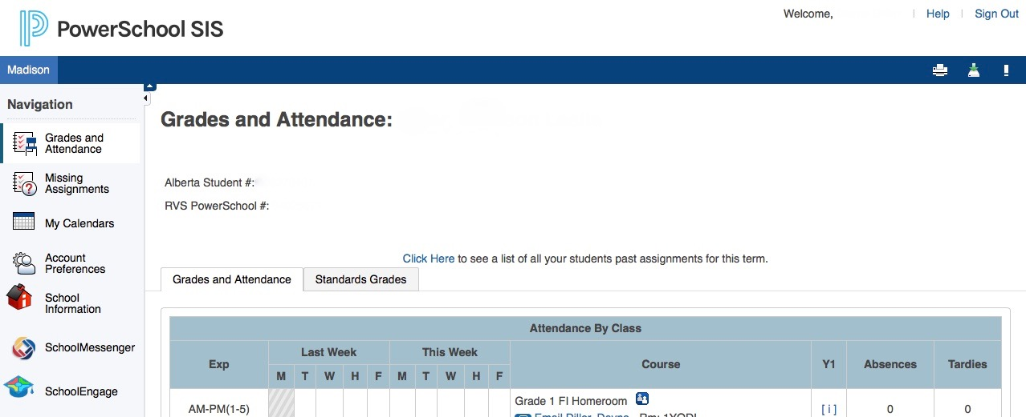
PowerSchool: Here's how to login
If you had a student at the school last year your username and password stays the same. If you are new to the school and you did your registration online everything was setup for you at that point, paper registrations received an email from the office. If you are having trouble with your login in please contact the office.
https://ps.rockyview.ab.ca
You can also access the link from our school website by clicking here:
This is the screen you will see when you first log in:

Slide 6
Please update your demographics forms and fill out the online permission slips!
To update your forms and information on file at the school click on SchoolEngage. This needs to be done at the beginning of each school year!

Slide 7
The names of your children you have registered will appear here. The name in lighter blue is the active student on screen. To switch between students simply click on the other students name.
This year rather than checking in on a list of assignments we are encouraging parents to check out the ’Standard Grades’ tab

Slide 8
You can flip between the current school year and previous school years
These are the subject areas being assessed to see your child's grade you need to expand each subject. You can do so by clicking on the small triangle subject by subject or by clicking expand all.

Slide 9
This year the standards being assessed are more detailed than they were on previous report cards. They are intended to give parents a good idea of where their child is having success and where they are requiring support. These standards are calculated by assignments entered by teachers.

Slide 10
If you would like more information on the assignments used to calculate the Standard Grades you can click back to the ‘Grades and Attendance’ tab

Slide 11
Once you are back under ‘Grades and Attendance’ click on the blue grade or [i] in the Y1 column to see a list of assignments.

Slide 12
Once you have the subject you would like open you will find a list of assignments. To see the grades for each assignment click on the logo here:
If your child's teacher has written a comment for the assignment you will see the blue speech bubble. Click on it to read the comment. ‘View’ in the last column will show details on the assignment or an assessment rubric

Slide 14
It’s a lot of clicking… we understand!
Remember we are encouraging parents to look at the ’Standards Grades’ page. You only need to do all of the clicking if you want more detailed information.

Slide 15
One last question we get a LOT…
Yes, there is an app… however, Rocky View is not recommending using the app as it does not show as much information as you will get from the website.
If you have the app, you can view the list of assignments, assignment grades and if you click over to ‘standards’ you can see the ’Standard Grades’ however there is no description of what those grades mean. That is only available on the website. This is a change we have requested from the app developer.
Is there an app we can use on our phones?
Why can’t I see anything on my phone?

Slide 16
MyBlueprint Parents have two options to view their child’s online portfolio:
Login as your child
Create a parent account
Pros:
Pros:
Username is already created.
Your child can login independently (age dependent).
You can add boxes with your child to show how you are supporting learning at home.
One login for all of your children
When you comment it will show up with your name so your child knows it was you
Cons:
You have to navigate multiple screens to add boxes
You can toggle between students on a computer but it doesn’t always load on a phone
It can get ‘stuck’ on your adult portfolio if you click on the student view
Cons:
If you comment on a post it will appear under your child’s name.
If you have multiple children you will have to login and log out each time to view each child’s portfolio.

Slide 17
Here’s what you’ll see logged in as your child:
Click on Archive to see what your child has added to their portfolio in previous years
The classroom teachers and students will ‘tag’ their work. You can filter out things like ‘goalsetting’ or ’science’ rather than scrolling through the boxes.
The speech bubble is where you can see comments that have been posted and can add comments

Slide 18
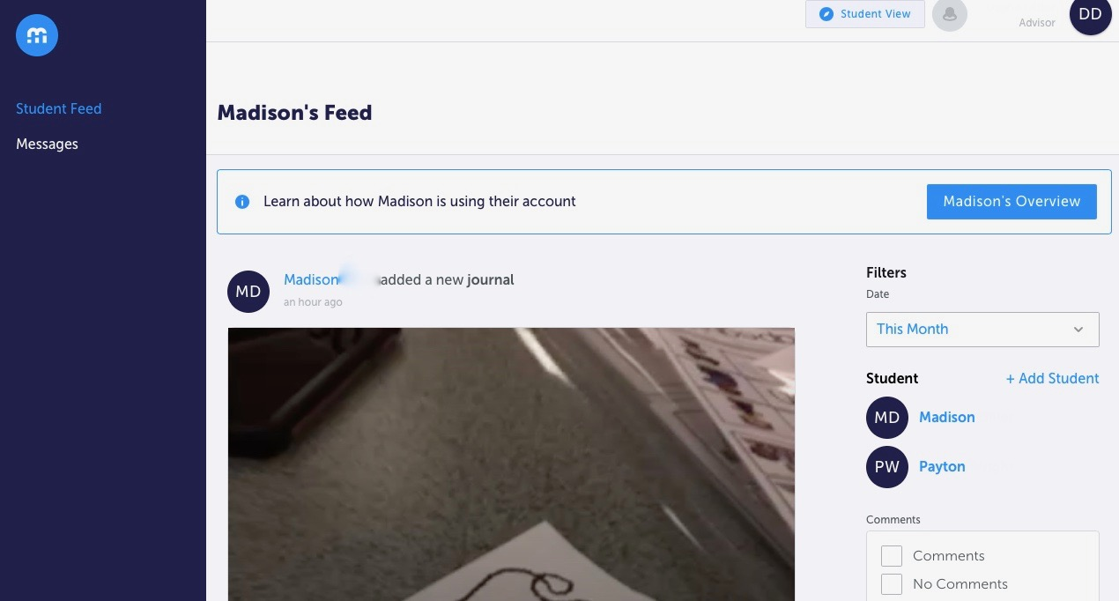
Here’s what you’ll see logged in as a parent/advisor: (on a computer)
Don’t click on this! It creates a Grade 13 account for you as an adult… unless you really want your own account.
On a phone it looks the same, only difference being you can’t see the student names to swap between them.
Toggle between students by clicking on their name in blue. Unfortunately K-6 can’t add siblings you need an invitation from the teacher
If you scroll down you can see your child’s posts in a ’blog roll’ format with comments from students and teachers posted below. You can add comments to each post from this screen.

Slide 19
We hope this presentation will help you navigate the assessments and artifacts teachers and students are sharing this year to communicate their achievements.
If ever you are unable to access this information please let your classroom teacher know and they can help you navigate it. If they can’t, they can direct you to someone on staff who can. We thank you for your patience, we are in our second year of reporting this way and as a staff are working together with staff and parents to communicate student learning in a timely and meaningful way.

Slide 20
Lastly, to support our Real-Time Reporting and MyBlueprint communications we are also holding student-led conferences in November and April. This is an opportunity for students to showcase in real life their classroom learning opportunities as well as a face to face conversation with your family and the classroom teachers.
Thank you so much for taking the time this evening to learn about your child's school year ahead, the second part of this presentation is more specific to your child's grade and classroom.

